Slide 1


VU
For view

Slide 2
VU
For view

Slide 3
VU
For view
Welcome to our ICU management system
Under Supervision Of
Prof. Dr.OsamaEl Komy

Slide 4

VU
For view
Hesham Mohamed Aldidamony
Talaat Amr Talaat
Abdelrahman Ahmed Mohammed
Sameh El Ahmady
Adel Elsaied Abdelazim
Ali Ahmed Ali
Alaa Mohamed Mahmoud
Welcome to our ICU management system
Under Supervision Of
Prof. Dr.OsamaEl Komy

Slide 5
VU
For view
Hesham Mohamed Aldidamony
Talaat Amr Talaat
Abdelrahman Ahmed Mohammed
Sameh El Ahmady
Adel Elsaied Abdelazim
Ali Ahmed Ali
Alaa Mohamed Mahmoud

Slide 6
VU
For view
Hesham Mohamed Aldidamony
Talaat Amr Talaat
Abdelrahman Ahmed Mohammed
Sameh El Ahmady
Adel Elsaied Abdelazim
Ali Ahmed Ali
Alaa Mohamed Mahmoud

Slide 7
VU
For view
Problem
Solution
Value of project
Hesham Mohamed Aldidamony
Talaat Amr Talaat
Abdelrahman Ahmed Mohammed
Sameh El Ahmady
Adel Elsaied Abdelazim
Ali Ahmed Ali
Alaa Mohamed Mahmoud
project protype
method and technologies
Implement

Slide 8
Problem
Some statistics to understand the problem
Deaths Due to Mismanagement: 200 (2%)
Medication Errors: 80
Equipment Failure: 50
Staffing Issues: 40
Procedural Lapses: 30
Average Response Time for Critical Events: 5 minutes
Mortality Rate with Response Time < 5 minutes: 15%
Mortality Rate with Response Time > 5 minutes: 25%
Medication Errors: Studies have shown that medication errors in ICUs can be significant. According to a study published in the Journal of Critical Care, medication errors occur in about 19% of ICU patients
Staffing Issues: Adequate staffing is crucial in ICUs. Research indicates that higher nurse-to-patient ratios are associated. A study in the American Journal of Respiratory and Critical Care Medicine found that each additional patient per nurse was associated with a 7% increase in the likelihood of patient death within 30 days of ICU admission.
Response Time: Delays in response to critical eventsare linked to higher mortality. A study in Critical Care Medicine found that delays of just a few minutes in the administration of life-saving interventions can significantly impact survival rates.
Solution
Value of project
project protype
method and technologies
Implement

Slide 9
Problem
The ratio of the number of patients in intensive care of nurse and doctors
Some statistics to understand the problem
Deaths Due to Mismanagement: 200 (2%)
Medication Errors: 80
Equipment Failure: 50
Staffing Issues: 40
Procedural Lapses: 30
Average Response Time for Critical Events: 5 minutes
Mortality Rate with Response Time < 5 minutes: 15%
Mortality Rate with Response Time > 5 minutes: 25%
Medication Errors: Studies have shown that medication errors in ICUs can be significant. According to a study published in the Journal of Critical Care, medication errors occur in about 19% of ICU patients
Staffing Issues: Adequate staffing is crucial in ICUs. Research indicates that higher nurse-to-patient ratios are associated. A study in the American Journal of Respiratory and Critical Care Medicine found that each additional patient per nurse was associated with a 7% increase in the likelihood of patient death within 30 days of ICU admission.
Response Time: Delays in response to critical eventsare linked to higher mortality. A study in Critical Care Medicine found that delays of just a few minutes in the administration of life-saving interventions can significantly impact survival rates.
patient
8
nurse
6
without VU
doctor
2
patient
8
nurse
4
with VU
doctor
1
Solution
Value of project
project protype
method and technologies
Implement

Slide 10

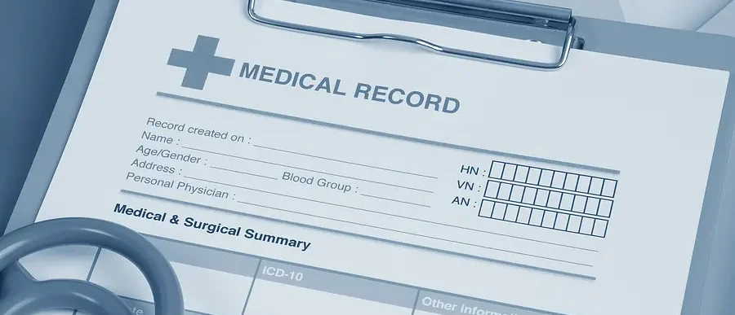
Problem
The ratio of the number of patients in intensive care of nurse and doctors
Deaths Due to Mismanagement: 200 (2%)
Medication Errors: 80
Equipment Failure: 50
Staffing Issues: 40
Procedural Lapses: 30
Average Response Time for Critical Events: 5 minutes
Mortality Rate with Response Time < 5 minutes: 15%
Mortality Rate with Response Time > 5 minutes: 25%
Manual Recording
(paper-based)
Miss Management
Continuous Monitoring Constraint
Medical Stuff Overloading
Manual Recording
(paper-based)
Miss Management
Continuous Monitoring Constraint
Medical Stuff Overloading
patient
8
nurse
6
without VU
doctor
2
patient
8
nurse
4
with VU
doctor
1
Solution
Value of project
project protype
method and technologies
Implement

Slide 11
Problem
The ratio of the number of patients in intensive care of nurse and doctors
Deaths Due to Mismanagement: 200 (2%)
Medication Errors: 80
Equipment Failure: 50
Staffing Issues: 40
Procedural Lapses: 30
Average Response Time for Critical Events: 5 minutes
Mortality Rate with Response Time < 5 minutes: 15%
Mortality Rate with Response Time > 5 minutes: 25%
Manual Recording
(paper-based)
Miss Management
Continuous Monitoring Constraint
Medical Stuff Overloading
Manual Recording
(paper-based)
Miss Management
Continuous Monitoring Constraint
Medical Stuff Overloading
patient
8
nurse
6
without VU
doctor
2
patient
8
nurse
4
with VU
doctor
1
Solution
A Mobile Application that works on Managing the ICU over the day through three techniques:
Computer Vision Algorithm (Automated Record for Vital Signs)
ESPP CAM 32 (Remote Monitoring)
Shift and Report Management
Value of project
project protype
method and technologies
Implement

Slide 12
Manual Recording
(paper-based)
Miss Management
Continuous Monitoring Constraint
Medical Stuff Overloading
Problem
Solution
The ratio of the number of patients in intensive care of nurse and doctors
Deaths Due to Mismanagement: 200 (2%)
Medication Errors: 80
Equipment Failure: 50
Staffing Issues: 40
Procedural Lapses: 30
Average Response Time for Critical Events: 5 minutes
Mortality Rate with Response Time < 5 minutes: 15%
Mortality Rate with Response Time > 5 minutes: 25%
Value of project
Manual Recording
(paper-based)
Miss Management
Continuous Monitoring Constraint
Medical Stuff Overloading
patient
8
nurse
6
project protype
without VU
doctor
2
method and technologies
patient
8
nurse
4
Implement
with VU
doctor
1
A Mobile Application that works on Managing the ICU over the day through three techniques:
Computer Vision Algorithm (Automated Record for Vital Signs)
ESPP CAM 32 (Remote Monitoring)
Shift and Report Management

Slide 13
Problem
Solution
Mobile Application that works on Managing the ICU over the day through three techniques:
Computer Vision Algorithm (Automated Record for Vital Signs)
ESPP CAM 32 (Remote Monitoring)
Shift and Report Management
Deaths Due to Mismanagement: 200 (2%)
Medication Errors: 80
Equipment Failure: 50
Staffing Issues: 40
Procedural Lapses: 30
Average Response Time for Critical Events: 5 minutes
Mortality Rate with Response Time < 5 minutes: 15%
Mortality Rate with Response Time > 5 minutes: 25%
Manual Recording
(paper-based)
Miss Management
Continuous Monitoring Constraint
Medical Stuff Overloading
Value of project
project protype
method and technologies
Implement

Slide 14
Problem
Solution
Value of project
project protype
method and technologies
Implement

Slide 15
Problem
Manual Recording
(paper-based)
Miss Management
Continuous Monitoring Constraint
Medical Stuff Overloading
Solution
A Mobile Application that works on Managing the ICU over the day through three techniques:
Computer Vision Algorithm (Automated Record for Vital Signs)
ESPP CAM 32 (Remote Monitoring)
Shift and Report Management
Value of project
Monitoring vital functions provides real-time data that enables the medical team to identify any health problems before they worsen.
Improving health outcomes regular monitoring contributes to better treatment outcomes and reduces mortality rates.
Cost saving and Resource optimizations.
Improved Operational Efficiency
medical staff to focus more on patient care rather than administrative tasks .
Empowerment of healthcare providers
remote monitoring capabilities empower healthcare providers to monitor patients from anywhere, allowing them to attend to essential activities without compromising patient care quality.
Early Detection of complications
allows for quick intervention and immediate treatment of any emergency situations.
Deaths Due to Mismanagement: 200 (2%)
Medication Errors: 80
Equipment Failure: 50
Staffing Issues: 40
Procedural Lapses: 30
Average Response Time for Critical Events: 5 minutes
Mortality Rate with Response Time < 5 minutes: 15%
Mortality Rate with Response Time > 5 minutes: 25%
Manual Recording
(paper-based)
Miss Management
Continuous Monitoring Constraint
Medical Stuff Overloading
project protype
method and technologies
Implement

Slide 16
Problem
Manual Recording
(paper-based)
Miss Management
Continuous Monitoring Constraint
Medical Stuff Overloading
A Mobile Application that works on Managing the ICU over the day through three techniques:
Computer Vision Algorithm (Automated Record for Vital Signs)
ESPP CAM 32 (Remote Monitoring)
Shift and Report Management
Problem
Solution
Value of project
Monitoring vital functions provides real-time data that enables the medical team to identify any health problems before they worsen.
Improving health outcomes regular monitoring contributes to better treatment outcomes and reduces mortality rates.
Cost saving and Resource optimizations.
Improved Operational Efficiency
medical staff to focus more on patient care rather than administrative tasks .
Empowerment of healthcare providers
remote monitoring capabilities empower healthcare providers to monitor patients from anywhere, allowing them to attend to essential activities without compromising patient care quality.
Early Detection of complications
allows for quick intervention and immediate treatment of any emergency situations.
Deaths Due to Mismanagement: 200 (2%)
Medication Errors: 80
Equipment Failure: 50
Staffing Issues: 40
Procedural Lapses: 30
Average Response Time for Critical Events: 5 minutes
Mortality Rate with Response Time < 5 minutes: 15%
Mortality Rate with Response Time > 5 minutes: 25%
Manual Recording
(paper-based)
Miss Management
Continuous Monitoring Constraint
Medical Stuff Overloading
project protype
method and technologies
Implement
method and technologies
Implement

Slide 17
Problem
Manual Recording
(paper-based)
Miss Management
Continuous Monitoring Constraint
Medical Stuff Overloading
Monitoring vital functions provides real-time data that enables the medical team to identify any health problemsbefore they worsen.
Improving health outcomes regular monitoring contributes to better treatment outcomes and reduces mortality rates.
Cost saving and Resource optimizations.
Problem
Solution
Value of project
project protype
method and technologies
Implement
method and technologies
Implement

Slide 18

Problem
Solution
Manual Recording
(paper-based)
Miss Management
Continuous Monitoring Constraint
Medical Stuff Overloading
A Mobile Application that works on Managing the ICU over the day through three techniques:
Computer Vision Algorithm (Automated Record for Vital Signs)
ESPP CAM 32 (Remote Monitoring)
Shift and Report Management
Problem
Solution
Value of project
Monitoring vital functions provides real-time data that enables the medical team to identify any health problems before they worsen.
Improving health outcomes regular monitoring contributes to better treatment outcomes and reduces mortality rates.
Cost saving and Resource optimizations.
project protype
Improved Operational Efficiency
medical staff to focus more on patient care rather than administrative tasks .
Empowerment of healthcare providers
remote monitoring capabilities empower healthcare providers to monitor patients from anywhere, allowing them to attend to essential activities without compromising patient care quality.
Early Detection of complications
allows for quick intervention and immediate treatment of any emergency situations.
Deaths Due to Mismanagement: 200 (2%)
Medication Errors: 80
Equipment Failure: 50
Staffing Issues: 40
Procedural Lapses: 30
Average Response Time for Critical Events: 5 minutes
Mortality Rate with Response Time < 5 minutes: 15%
Mortality Rate with Response Time > 5 minutes: 25%
Manual Recording
(paper-based)
Miss Management
Continuous Monitoring Constraint
Medical Stuff Overloading
method and technologies
Implement
project protype
method and technologies
Implement

Slide 19

Problem
Solution
Manual Recording
(paper-based)
Miss Management
Continuous Monitoring Constraint
Medical Stuff Overloading
A Mobile Application that works on Managing the ICU over the day through three techniques:
Computer Vision Algorithm (Automated Record for Vital Signs)
ESPP CAM 32 (Remote Monitoring)
Shift and Report Management
Value of project
Monitoring vital functions provides real-time data that enables the medical team to identify any health problems before they worsen.
Improving health outcomes regular monitoring contributes to better treatment outcomes and reduces mortality rates.
Cost saving and Resource optimizations.
project protype
Deaths Due to Mismanagement: 200 (2%)
Medication Errors: 80
Equipment Failure: 50
Staffing Issues: 40
Procedural Lapses: 30
Average Response Time for Critical Events: 5 minutes
Mortality Rate with Response Time < 5 minutes: 15%
Mortality Rate with Response Time > 5 minutes: 25%
Manual Recording
(paper-based)
Miss Management
Continuous Monitoring Constraint
Medical Stuff Overloading
project protype
method and technologies
Implement

Slide 20

Problem
Solution
Manual Recording
(paper-based)
Miss Management
Continuous Monitoring Constraint
Medical Stuff Overloading
A Mobile Application that works on Managing the ICU over the day through three techniques:
Computer Vision Algorithm (Automated Record for Vital Signs)
ESPP CAM 32 (Remote Monitoring)
Shift and Report Management
Value of project
Monitoring vital functions provides real-time data that enables the medical team to identify any health problems before they worsen.
Improving health outcomes regular monitoring contributes to better treatment outcomes and reduces mortality rates.
Cost saving and Resource optimizations.
project protype
project protype
method and technologies
Implement

Slide 21
Problem
Solution
Manual Recording
(paper-based)
Miss Management
Continuous Monitoring Constraint
Medical Stuff Overloading
A Mobile Application that works on Managing the ICU over the day through three techniques:
Computer Vision Algorithm (Automated Record for Vital Signs)
ESPP CAM 32 (Remote Monitoring)
Shift and Report Management
Value of project
Monitoring vital functions provides real-time data that enables the medical team to identify any health problems before they worsen.
Improving health outcomes regular monitoring contributes to better treatment outcomes and reduces mortality rates.
Cost saving and Resource optimizations.
project protype
project protype
method and technologies
Implement

Slide 22
Problem
Solution
Manual Recording
(paper-based)
Miss Management
Continuous Monitoring Constraint
Medical Stuff Overloading
A Mobile Application that works on Managing the ICU over the day through three techniques:
Computer Vision Algorithm (Automated Record for Vital Signs)
ESPP CAM 32 (Remote Monitoring)
Shift and Report Management
Value of project
Monitoring vital functions provides real-time data that enables the medical team to identify any health problems before they worsen.
Improving health outcomes regular monitoring contributes to better treatment outcomes and reduces mortality rates.
Cost saving and Resource optimizations.
project protype
project protype
method and technologies
Implement

Slide 23

Problem
Solution
Manual Recording
(paper-based)
Miss Management
Continuous Monitoring Constraint
Medical Stuff Overloading
A Mobile Application that works on Managing the ICU over the day through three techniques:
Computer Vision Algorithm (Automated Record for Vital Signs)
ESPP CAM 32 (Remote Monitoring)
Shift and Report Management
Value of project
Monitoring vital functions provides real-time data that enables the medical team to identify any health problems before they worsen.
Improving health outcomes regular monitoring contributes to better treatment outcomes and reduces mortality rates.
Cost saving and Resource optimizations.
project protype
project protype
method and technologies
Implement

Slide 24
Problem
Solution
Manual Recording
(paper-based)
Miss Management
Continuous Monitoring Constraint
Medical Stuff Overloading
A Mobile Application that works on Managing the ICU over the day through three techniques:
Computer Vision Algorithm (Automated Record for Vital Signs)
ESPP CAM 32 (Remote Monitoring)
Shift and Report Management
Value of project
Monitoring vital functions provides real-time data that enables the medical team to identify any health problems before they worsen.
Improving health outcomes regular monitoring contributes to better treatment outcomes and reduces mortality rates.
Cost saving and Resource optimizations.
project protype
project protype
method and technologies
Implement

Slide 25
Problem
Solution
Problem
Solution
Value of project
project protype
method and technologies
Implement

Slide 26
Problem
Solution
Value of project
project protype
method and technologies
Implement

Slide 27





Problem
Solution
Value of project
project protype
method and technologies
Data base :
MySql
Mobile Application :
Flutter coded by Dart Programming language
spring boot for Backend
So what We used?
Computer Vision
openCV library coded by python programming language
Implement
ESP CAM 32 :
Aurduino coded by C programming language

Slide 28
Problem
Solution
Value of project
project protype
method and technologies
Data base :
MySql
Mobile Application :
Flutter coded by Dart Programming language
spring boot for Backend
Computer Vision
openCV library coded by python programming language
Implement
ESP CAM 32 :
Aurduino coded by C programming language

Slide 29
Problem
Solution
Value of project
project protype
method and technologies
Mobile Application :
Flutter coded by Dart Programming language
spring boot for Backend
Data base :
MySql
Computer Vision
openCV library coded by python programming language
ESP CAM 32 :
Aurduino coded by C programming language
Implement

Slide 30
Mobile Application :
Flutter coded by Dart Programming language
spring boot for Backend
Data base :
MySql
Computer Vision
openCV library coded by python programming language
ESP CAM 32 :
Aurduino coded by C programming language
Problem
Solution
Value of project
project protype
method and technologies
Implement

Slide 31
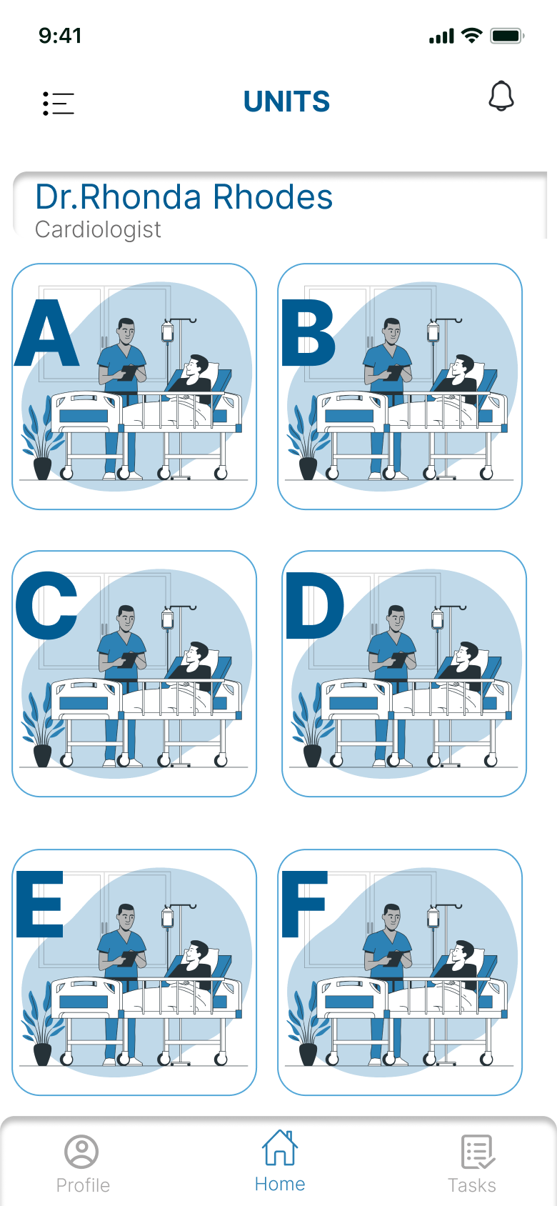
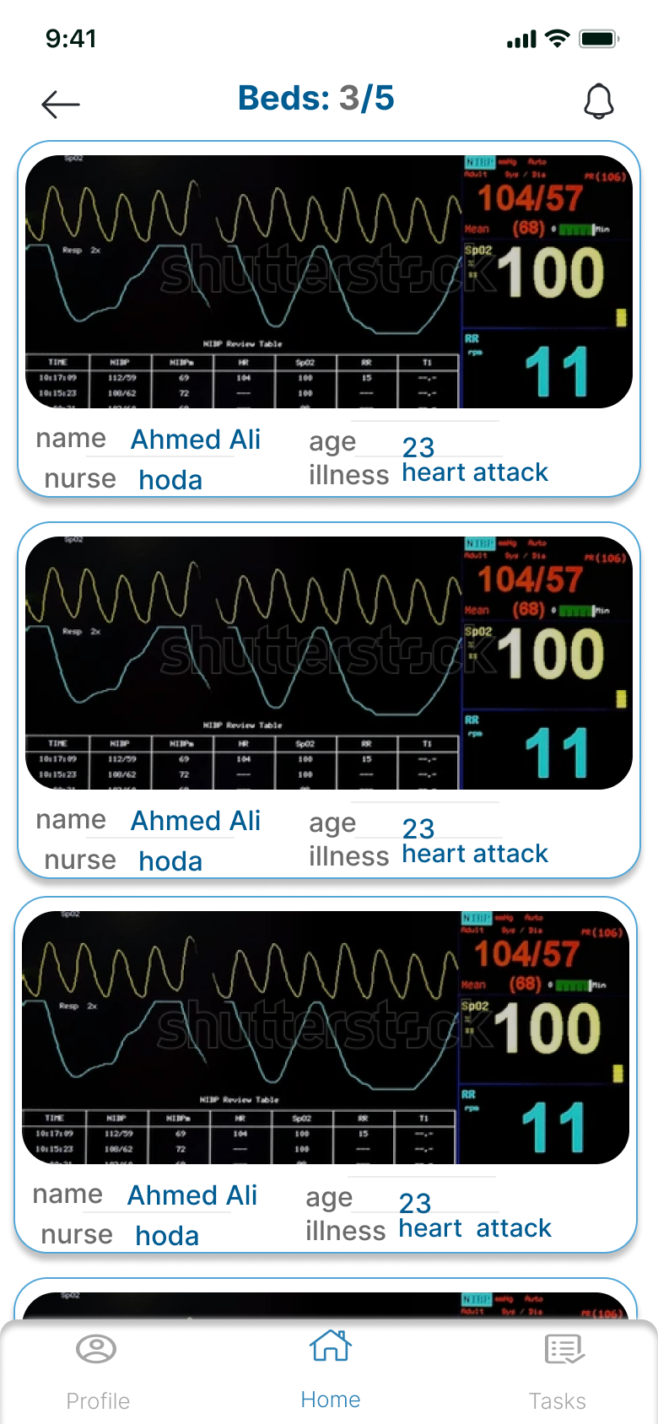
Problem
Solution
Value of project
project protype
method and technologies
Implement
Hardware first:
We implement the ESP CAM to share real-time streaming data from monitor to Mobile Application.
The ESP connection is done and conducted more than once to ensure that they able to share real-time data
Second communicative part :
Doctor or nurse :- consists of 2 pages (Home pages)
Patient:- consists of 5 pages

Slide 32
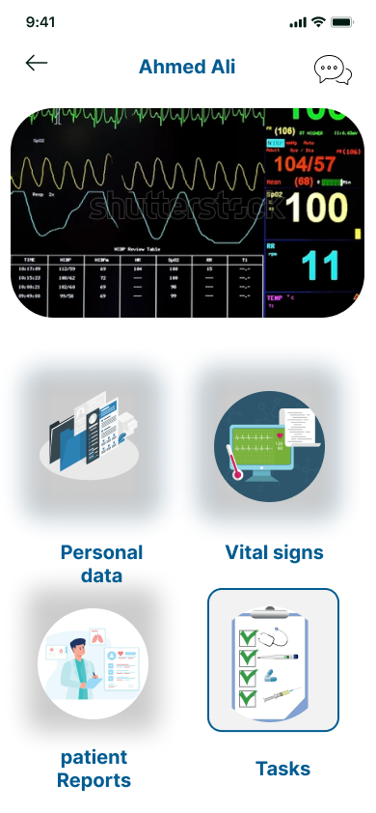
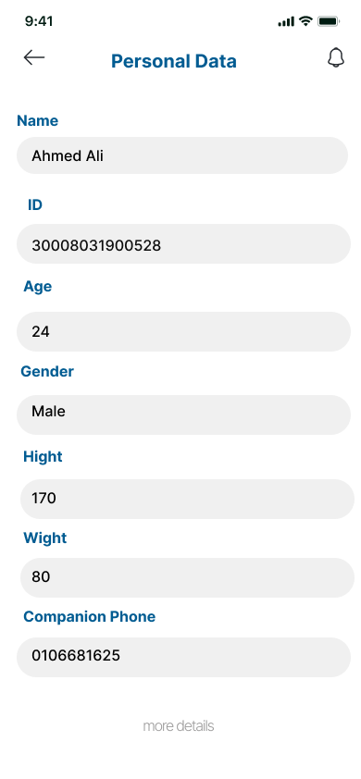
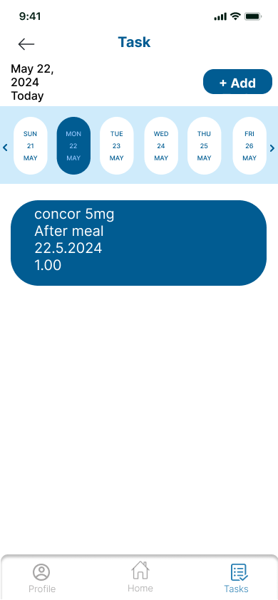
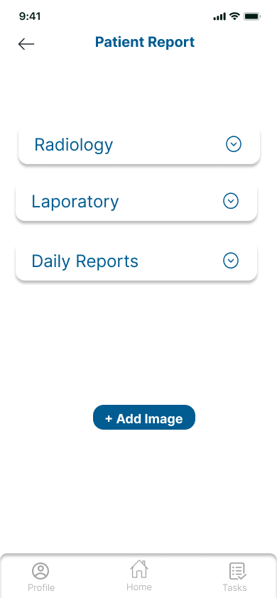
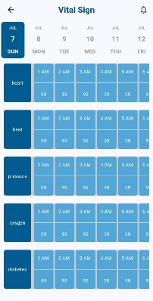
Problem
Solution
Value of project
project protype
method and technologies
Implement
Hardware first:
We implement the ESP CAM to share real-time streaming data from monitor to Mobile Application.
The ESP connection is done and conducted more than once to ensure that they able to share real-time data
Second communicative part :
Doctor or nurse :- consists of 2 pages (Home pages)
Patient:- consists of 5 pages

Slide 33
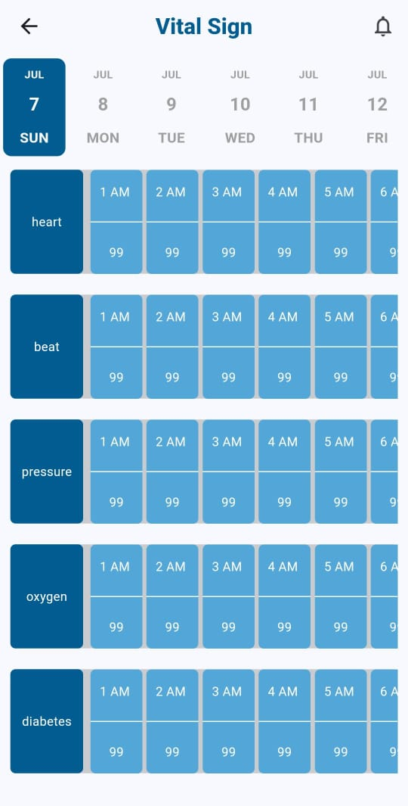
Problem
Solution
Value of project
project protype
method and technologies
Implement
Second communicative part :
Doctor or nurse :- consists of 2 pages (Home pages)
Patient:- consists of 5 pages

Slide 34
Problem
Solution
Value of project
project protype
method and technologies
Implement
Second communicative part :
Doctor or nurse :- consists of 2 pages (Home pages)
Patient:- consists of 5 pages

Slide 35
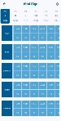
Problem
Solution
Value of project
project protype
method and technologies
Implement

Slide 36

Problem
Solution
Value of project
project protype
method and technologies
Implement
Conclusion
Future
work
Importance of monitor for ICU Patients .
Importance of regular monitoring.
Improving of Healthcare community .
Increasing the number of mortality lead the medical team seek to reducing that by Technology.

Slide 37
Importance of monitor for ICU Patients .
Importance of regular monitoring.
Improving of Healthcare community .
Increasing the number of mortality lead the medical team seek to reducing that by Technology.
Conclusion
Future
work

Slide 38
Importance of monitor for ICU Patients .
Importance of regular monitoring.
Improving of Healthcare community .
Increasing the number of mortality lead the medical team seek to reducing that by Technology.
Conclusion
Future
work

Slide 39
Importance of monitor for ICU Patients .
Importance of regular monitoring.
Improving of Healthcare community .
Increasing the number of mortality lead the medical team seek to reducing that by Technology.
Adding new feature that may be detect happens of risk before occur
(ML&DL Algorithms).
Adding new Technology to increase efficiency and quality of real-time streaming data and analysis data of monitor.
Developing the idea later to be available on websites as well.
Future
work
Conclusion

Slide 40
Importance of monitor for ICU Patients .
Importance of regular monitoring.
Improving of Healthcare community .
Increasing the number of mortality lead the medical team seek to reducing that by Technology.
Conclusion
Adding new feature that may be detect happens of risk before occur
(ML&DL Algorithms).
Adding new Technology to increase efficiency and quality of real-time streaming data and analysis data of monitor.
Developing the idea later to be available on websites as well.
Future
work

Slide 41
Now lets take a view about
VU
Conclusion
Future
work
…

Slide 42
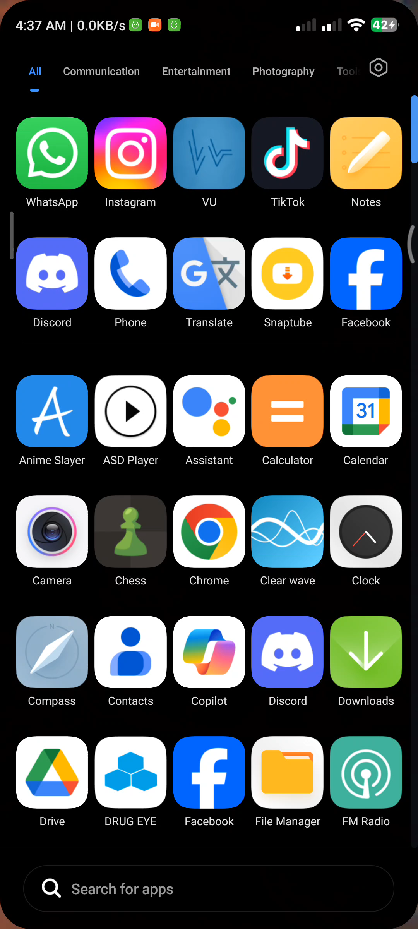
Conclusion
Future
work
Now lets take a view about
VU
…

Slide 43
Conclusion
Future
work
Now lets take a view about
VU
…

